Slide 1
205 Nov 2, Class 18
Non-experimental designs
Final project planning

Slide 2
Intervention research in child development has repeatedly produced a paradoxical conclusion: In correlational studies, parental assistance with children’s homework has been associated with lower academic achievement. As a result, some psychologists have concluded in published reports that parents should not help their children with homework…

Slide 3
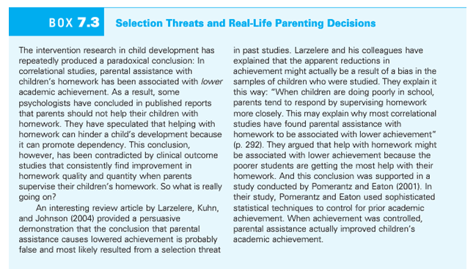

Slide 4
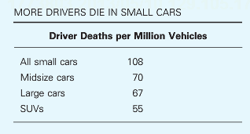
Multiple accounts consistent with the data
Large cars are safer than small cars
Small cars are more dangerous than large cars
Safest cars: Acura RX SUV, Acura RL sedan, Audi 4
Most dangerous cars: Chevy Cobalt, Ford Focus, Mazda 3

Slide 5
Validity
Q1. Why are experimental studies higher in internal validity?
Q2. Why are nonexperimental studies higher in external validity?

Slide 6
Non-experimental design
For each of the following 3 examples, indicate what kinds of non-experimental design would be used to study the phenomenon and also outline a 2-group experimental approach that could answer a question that might be inspired by the non-experimental work.
Q3. Pushing ahead in line
Q4. Locating the most popular painting in an art gallery
Q5. Studiousness in college students

Slide 7
Sugar and hyperactivity in children
“Sugar rush”: candy, cake, etc., leads to high-activity behavior in children
Why do many people think this is true?
What is the role of experimental versus non-experimental data in this common belief?

Slide 8
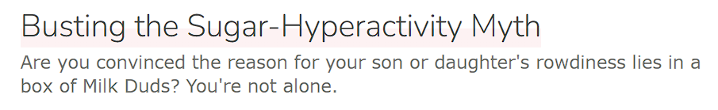
Experimental Research on Sugar
How would we design a study to refute this idea?
What is the fundamental problem with our experimental approach?

Slide 9
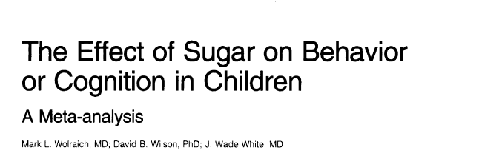
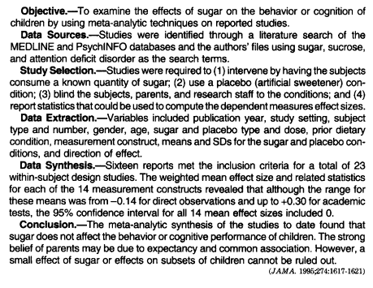
Meta-analysis: combined re-analysis of a set of published research studies
Provides additional sensitivity to small effect sizes
Can be used to argue for effect size = 0

Slide 10
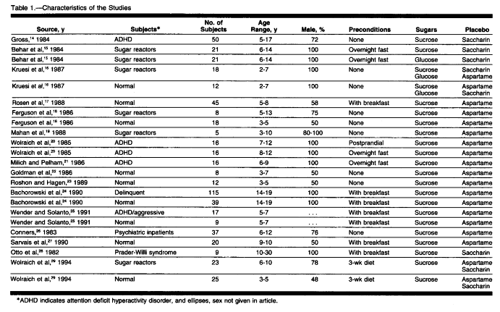

Slide 11
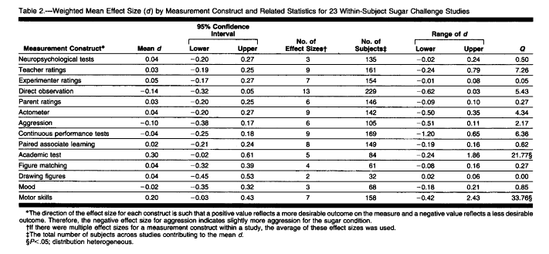

Slide 12
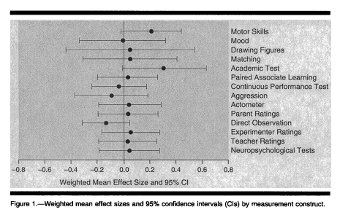
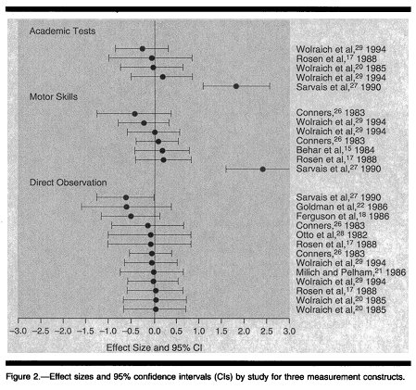
Forest Plots

Slide 13
Non-experimental designs
Collected in the real world outside the laboratory
Observation
Surveys
Qualitative research
Lack of control = less internal validity
As little as none in some cases
Collecting data in context = greater external validity
Little concern about applying outside the lab

Slide 14
For Fri, Nov 4
Final project proposals, initial outline
Read Plant et al. (2009), The Obama Effect
Chapter 15: Survey & Instrument Design
“Instrument” here means a well-established questionnaire that is an accepted operational definition of an important construct

